Slide 1
Lecture 2 Introduction to Machine Learning Fall Semester 2020-2021 ⇨ Cognition, IQ ad Making Sense
András Lőrincz
Department of Artificial Intelligence
Faculty of Informatics

Slide 2
Content
Approximate contents
1. Introduction
2. IQ and making sense
homunculus
Chinese room
Dennett
autoencoders
dense vs. sparse -- communication

Slide 3
IQ
What is intelligence? How can we measure it?
Question asked from group members: „Order your fellows according to intelligence!”
Groups and tests of different kinds
Correlations
Best correlating test set was chosen
What does it measure and what not?
Are these tests good?
What has been left out?
We come back to this issue when treating the problems of combinatorial explosion (next lecture)

Slide 4
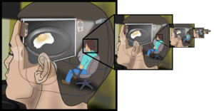
The issue of making sense
Searle: The homunculus fallacy
Brain works with representations
Who is making sense of these representations?
What is s/he using for making sense?
Is s/he using representations or something else?
If it something else, then what it is?

Slide 5
Homunculus Fallacy – Wikipedia
A dualist might argue that the homunculus inside the brain is an immaterial one (such as the Cartesian soul), or a mystic might assert that the homunculus is a recharacterization of the infinite consciousness of God (or true self), and thereby does not require a homunculus (or any form, spiritual or material) to have sensory experience, since such experience is a self-aware expression of the universe requiring no end to the regress other than the present moment itself.
A non-dualist may assert, similarly to the mystic, that a human life form (or any organism) is coterminous with and indivisible from its environment, with this unified field of awareness (i.e., universal consciousness) mistaking itself for a homunculus (or an ego). A neurosurgery professional may point to the cortical homunculus, a distorted representation of the human body, based on a neurological "map" of the areas and proportions of the brain dedicated to processing motor functions, or sensory functions, for different parts of the body. No evidence of further regress is present, indicating the presence of something akin to a soul. Thus, the regress argument is only valid if there can be no other explanation of the homunculus's cognition supplied, and the arguments of a first cause or a transcendental, formless consciousness (i.e., awareness underlying and beyond form) are rejected.

Slide 6
A resolution to the homunculus fallacy
Decision making (DM, or free will...) requires
the process of making sense and
reasoning based choice between alternatives (conscious DM)
reasoning is based on values
Daniel Dennett:
there are inputs and outputs
decision making is an output
making sense is apparent
no free will
Dennett says that
only a theory that explained conscious events in terms of unconscious events could explain consciousness at all: "To explain is to explain away".

Slide 7
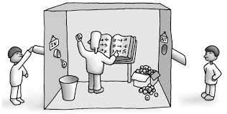
Do we have mind (intellect), if there is no making sense?
Searle: Chinese Room Argument
huge dictionary (i.e. Big Data)
fast search (i.e. lookup table)
output: solution...
Is this intelligence?

Slide 8
Resolution to the homunculus fallacy
The task is as follows
make sense of the input
by means of the representation
In other words (Lőrincz et al. 2002. J. Comp. Neurosci.)
a representation is good if
it can (produce, generate) derive (sg.)
(an approximation of) the input
Input: x
Representation: h
Estimated input: y
Identity matrix: I
h=Ix
y=Ih
Error: e=x-y=0
Input
Representation
Approximate Input
Autoencoder → Good!
Is an identity matrix OK? → Bad...
Why is it bad??

Slide 9
Underlying idea
Idea comes from language:
Text can be a compressed version of events (inputs...)
Autoencoder that compresses the input
the better the compression and
the better the approximate input
the more intelligent the system is
Is this true?
http://www.hutter1.net/prize/index.htm
AU$: 50,000
Input
Approximate Input
Represen-tation

Slide 10
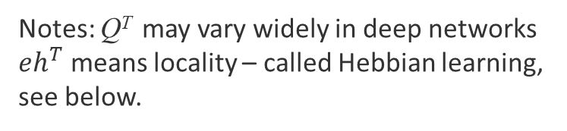

Related math
Cost: $J=\frac{1}{2}{\left|e\right|}^{2}=\frac{1}{2}{\left|x−Qh\right|}^{2}$
Optimization of $h:$ → $∆h∝ Q^{T}\left(x−Qh\right)=Q^{T}\left(x−y\right)=Q^{T}e$
Optimization of $Q$: → $∆Q∝ \left(x−Qh\right)h^{T}=\left(x−y\right)h^{T}=eh^{T}$
Input: x
Representation: h
Estimated input: y
Error: e=x-y ≠ 0
Matrices:
h=Q^{T}x
y=Qh
-I
Input
Approximate Input
Represen-tation
Q
Q^{T}
Notes: Q^{T} may vary widely in deep networks
$eh^{T}$ means locality – called Hebbian learning, see below.

Slide 11
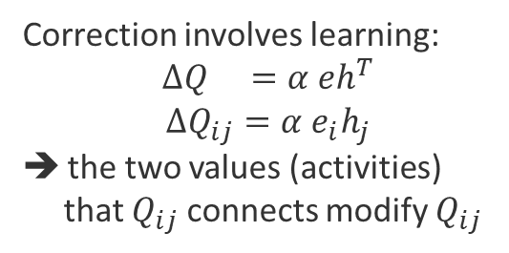
Hebbian learning
First step is feedforward (h=Q^{T}x),there is no learning here
Input x
Approx Input y
Represen-tation h
Q
Q^{T}
Correction $∆h∝ Q^{T}\left(x−Qh\right)=Q^{T}\left(x−y\right)=Q^{T}e$
-I
Correction involves learning:
$∆Q =α eh^{T}$
$∆Q_{ij}=α e_{i}h_{j}$
the two values (activities)
that $Q_{ij}$ connects modify $Q_{ij}$
Error: e=x-y
New approx Input y
New repr.
h+Δh
Q
Q^{T}

Slide 13
Occam’ razor
Bertrand Russell:
"Whenever possible, substitute constructions out of known entities for inferences to unknown entities.„
"Entities are not to be multiplied without necessity„
Theorem in information theory → Occam's razor is a direct result of basic probability theory.
William H. Jefferys and James O. Berger (1991):
"A hypothesis with fewer adjustable parameters will automatically have an enhanced posterior probability, due to the fact that the predictions it makes are sharp."
➔ No info about the scale of compression for each input...

Slide 14

Autoencoder with sparse coding
Large representation looks trivial and stupid...
but: the brain does something similar
Let’s limit the number of non-zero components...
Represen-tation
ŷ ≈ Ah → but with a few non-zero components...
Input
Approximate Input
J = ½ ||y − ŷ||₂² + λ ||h||₀
J = ½ ||y − Ah||₂² + λ ||h||₀
A
y h ŷ
Occam + Russel say:
explain with the unknown entities (i.e., with the components of h)
the fewer the better
However: combinatorial explosion...
But: comes L₁ Magic (not here)

Slide 15
Another problem is learning

Slide 16
Learning task in the general case
Three-layer networks
1989:
Multilayer feedforward networks are universal approximators.
K. Hornik, M. Stinchcombe, and H. White.
Neural Networks, pages 359–366
1997-1998
The computational intractability of training sigmoidal neural networks.
Jones, L. K. – IEEE. Tr. on Information Theory, 43(1), 167-173, 1997.
Some complexity results for perceptron networks.
B. Hammer – In: ICANN, Springer, 639–644, 1998
So: combinatorical explosion, again...

Slide 17
But, they work: Origins...
Convolutinal deep networks (LeCun):
Template matching – fast: for n pixel n log n computations
Today: parallel with GPU...
Deep networks in general (Hinton):
Trick: stacked autoencoder
Steps of stacking
Autoencoder that compresses a bit
1st representation—train classifiers-tune autoencoder, too
Drop classifiers
Build an autoencoder that compresses a bit
The input of the new autoencoder is the 1st reprezentation
2nd representation—train classifiers-tune both autoencoders
Drop classifiers, if the results are not good, and go further

Slide 18
In picture

Slide 19
What can such networks do (using much more sophisticated training strategies) ??

Slide 20
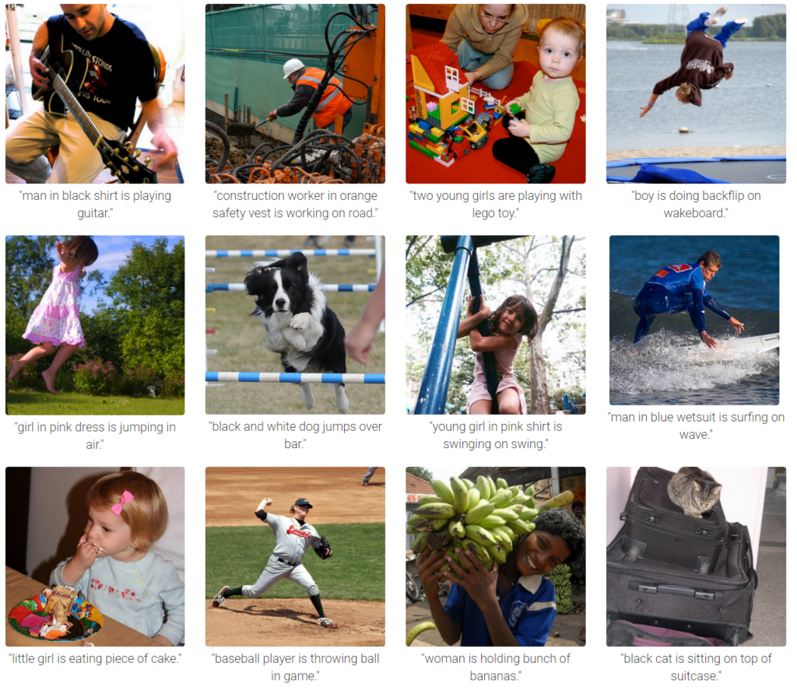
„Can” a Deep Network interpret???
Input—output példa
(1)
Man in black shirt is playing the guitar
(2)
Construction worker in orange safety vest is working on the road
(11)
Two girls are playing Lego toy
(5)
Boy is doing blackflip on the wakeboard
Andrej Karpathy, et al
Stanford Egyetem
Algorithms are strong
but the answer is NO…
(7)
Girl in pink dress is jumping in air
(12)
Black and white dog jumps over bar
(4) Young girl in pink shirt is swinging on the swing
(8)
Man in blue wetsuit is surfing on the wave
(10)
Little girl is eating piece of cake
(3)
Baseball player is throwing ball
(9)
Woman is holding buch of bananas
(6)
Black cat is sitting on top of suitcase

Slide 21
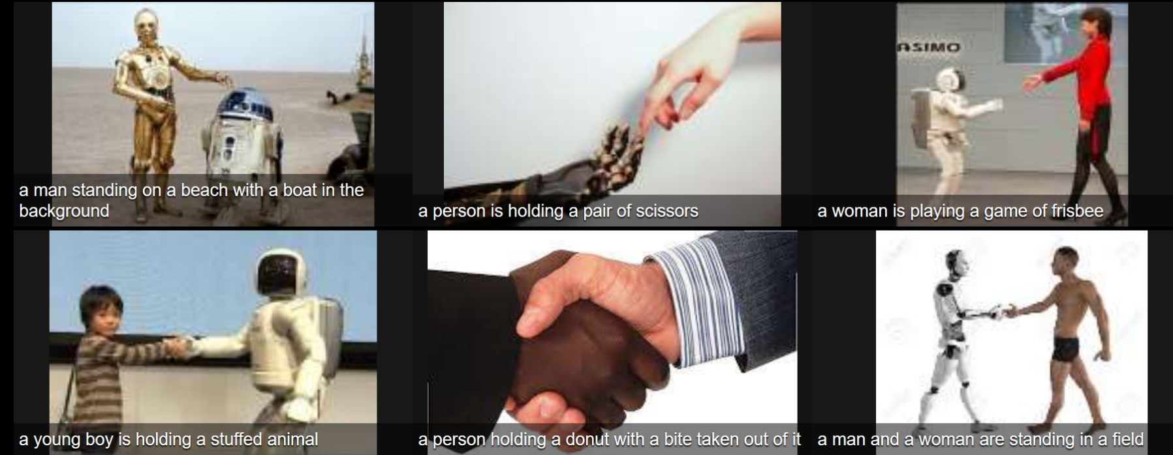
„Can” a Deep Network interpret???
Input—output példa
(1)
Man on the beach with boat in the background
(2)
Person is holding a pair of scissors
(3)
A woman is playing the game of frisbee
(4)
Young boy is holding a stuffed animal
(6)
A person is holding a donut with a bite taken out of it
(5)
A man and a woman are standing in a field

Slide 22
Mathematical Tour on Probability Theory and related homeworks and Questions about „what we have learned”

Slide 23



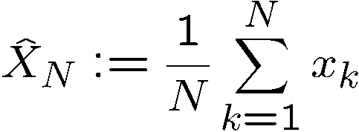
Mathematical tour Law of large numbers
X stochastic variable,
has finite expected value,
has finite standard deviation,
we take N independent samples from X:
x₁, x₂, …, x_{N}
x_{k}’s are independent
average:

Slide 24

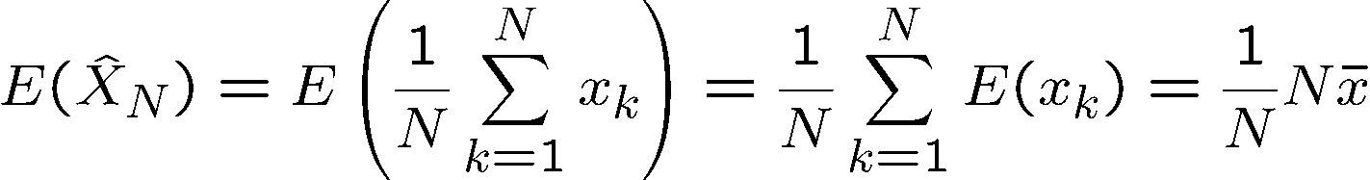
Mathematical tour Law of large numbers
Proof: trivial

Slide 25
This
is the
END!
BUT go further
for homeworks and
for the questions!
lorincz@inf.elte.hu

Slide 26

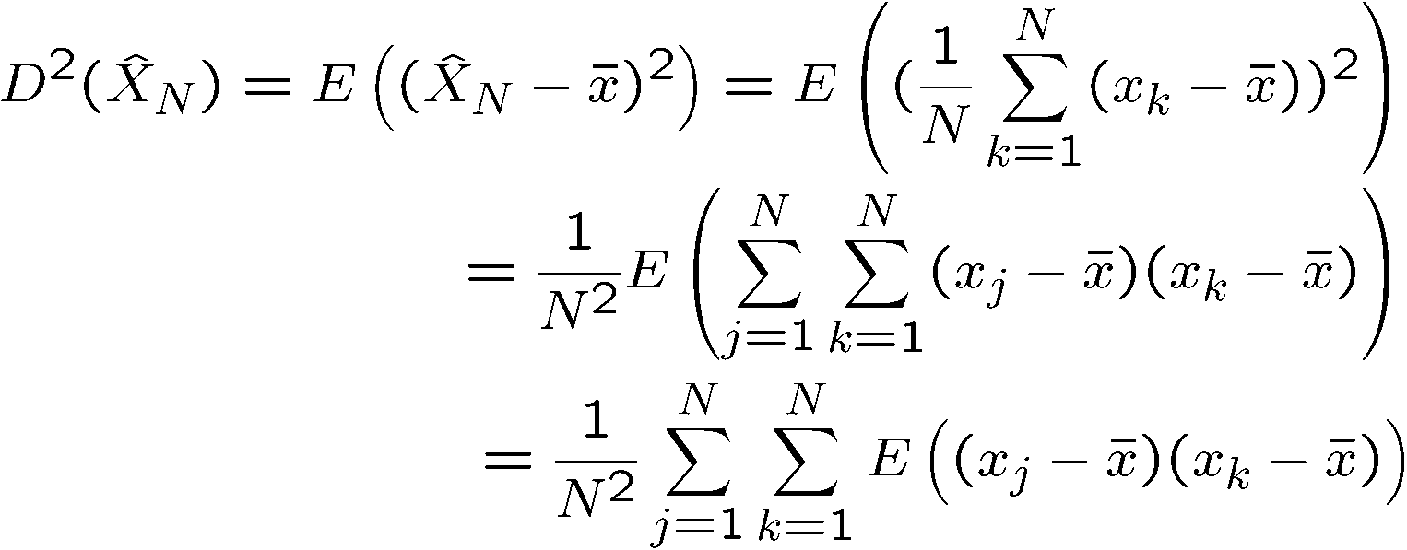

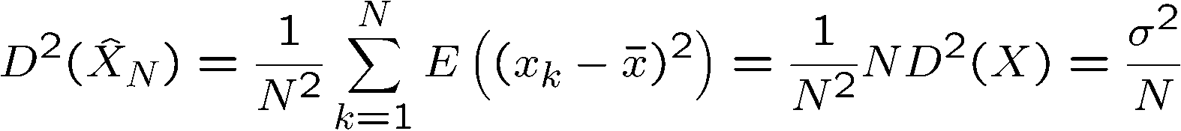
Mathematical tour Law of large numbers
Theorem:
Proof:
if i≠j, then due to independece:
and thus:

Slide 27
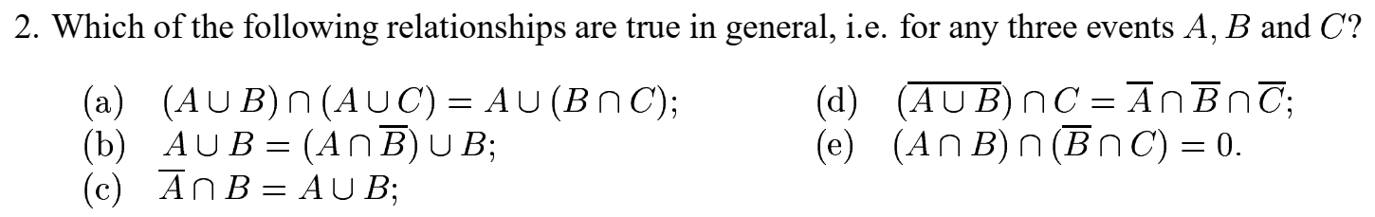
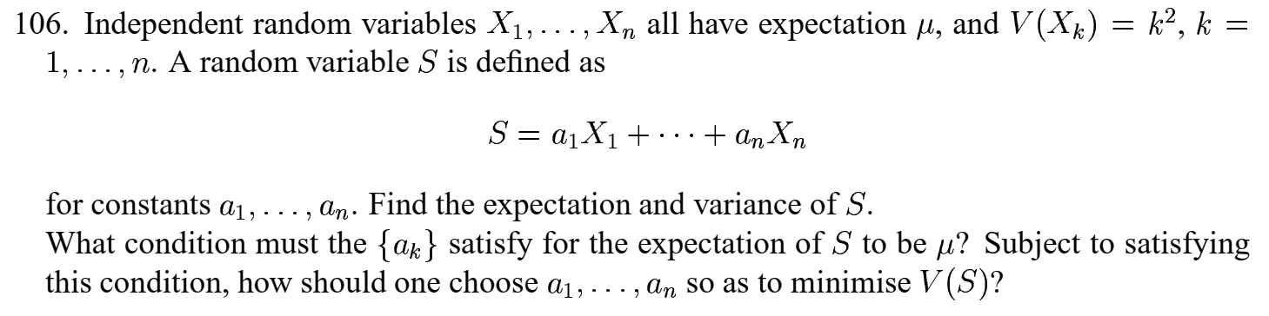
Homeworks from Martin Ridout 107 Exercises in Probability Theory University of Kent

Slide 28
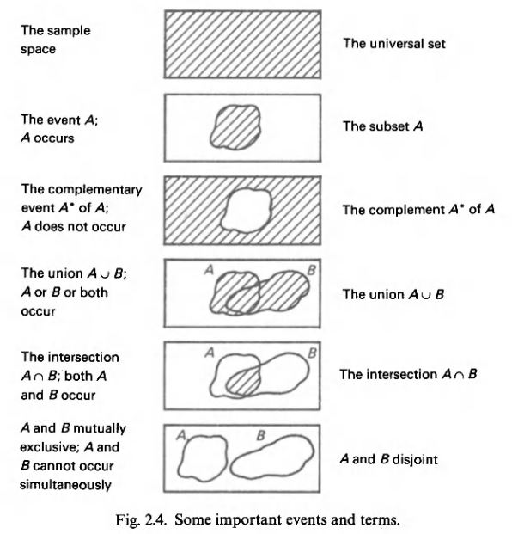
Probability and Statistics Harald Lang Gunnar Blom Notations

Slide 29
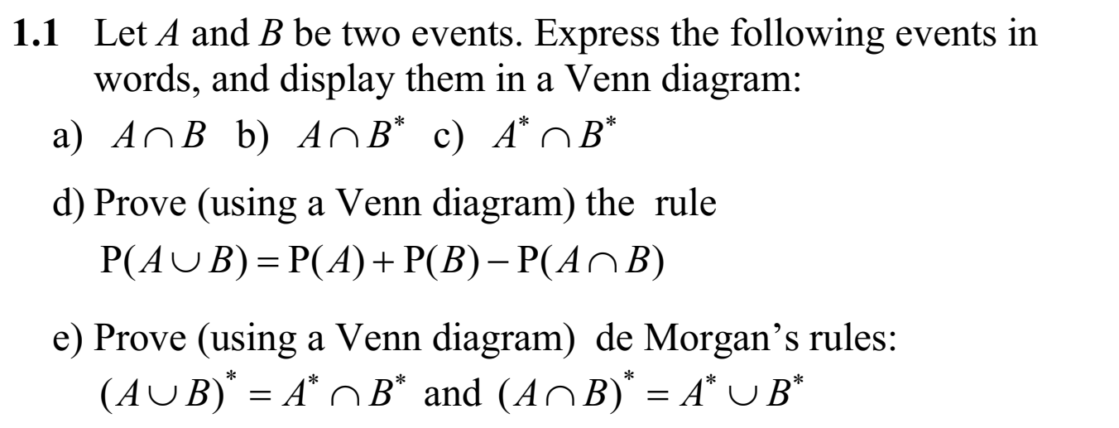
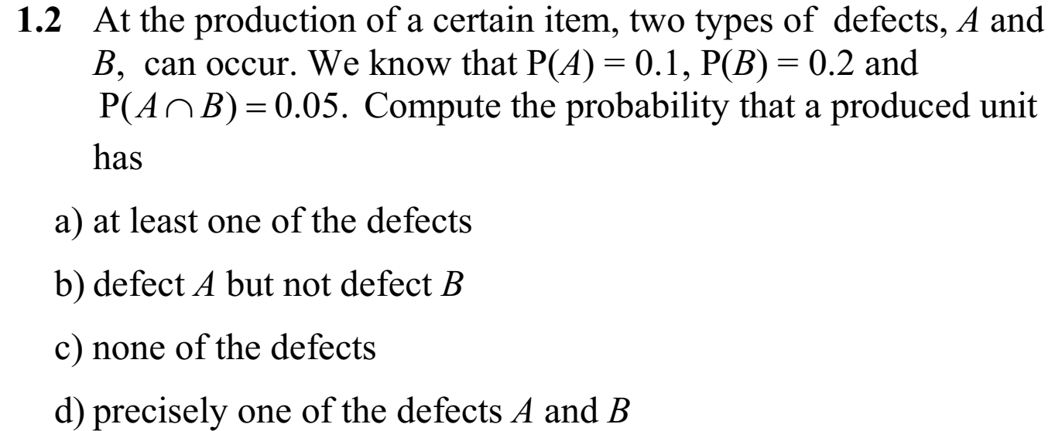
Probability and Statistics Harald Lang Gunnar Blom

Slide 30
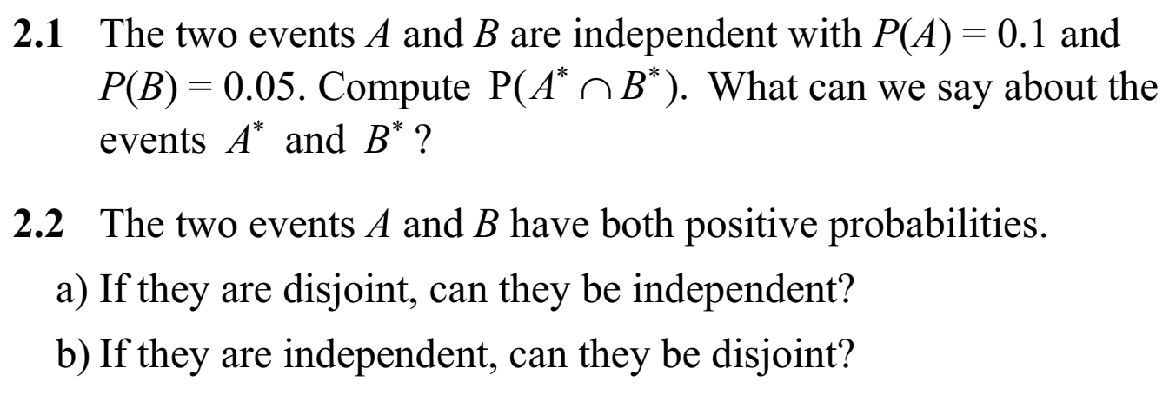
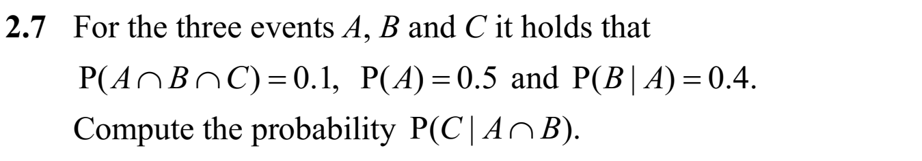
Probability and Statistics Harald Lang Gunnar Blom

Slide 31
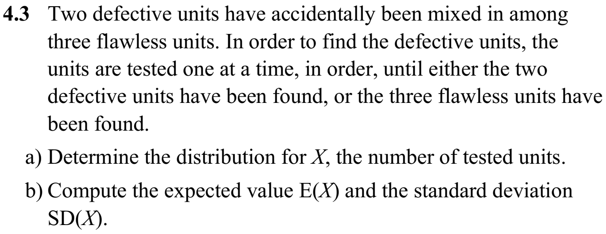
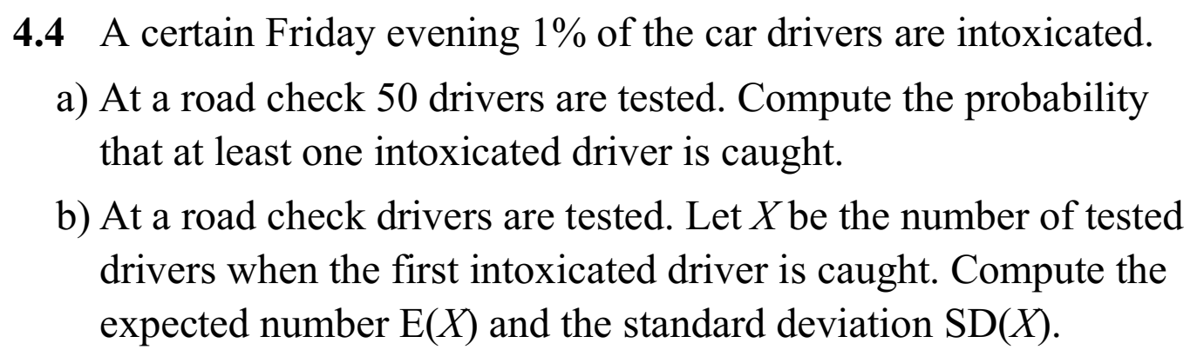
Probability and Statistics Harald Lang Gunnar Blom KTH

Slide 32
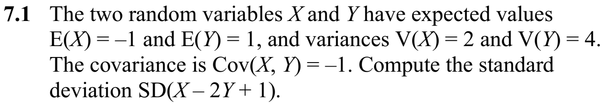
Probability and Statistics Harald Lang Gunnar Blom KTH

Slide 33
Questions at the exam
What is the expected value of a random/stochastic variable?
What is the probability distribution of a discrete stochastic variable?
What is the average value of the result when a stochastic variable is sampled N times?
What is the definition of standard deviation?
What is the relation between the standard deviation and the expected value of a discrete stochastic variable?
What does the „Law of large numbers” claim? State it!
What does the „Law of large numbers” claim? Prove it!

